Slide 1
FIGMA UI/UX DESIGN SHOWCASE
CRAVEYARD
Campus food delivery app · Designed and prototyped in Figma
PART 1 · DESIGN APPROACH
PART 2 · APP FUNCTIONALITIES
Abhijit Das Ayon
Md Habibur Rahman Fuyad
ID: 0182420012101038
ID: 0182420012101032
Project overview and Figma workflow
Screen-by-screen walkthrough
Notes:
Good day everyone. We are presenting CraveYard, a campus food delivery app designed and prototyped entirely in Figma. I am Abhijit Das Ayon and I will cover the project overview and how we worked in Figma. My teammate Md Habibur Rahman Fuyad will then walk you through the app screens one by one.

Slide 2
What I will cover in Part 1
Part 1 | Abhijit Das Ayon
01
02
03
04
Project overview
Collaboration
Carousels & scroll
Prototyping
The master canvas and what we built
Working together in one live file
Swipeable rows and long pages
Linking every button and flow
05
06
07
NEXT
Part 2: App walkthrough
Community kits
Figma agent & theme
Experimental pages
Reusing assets and our own parts
One consistent look across frames
Designing and testing before production
Presented by Fuyad
Notes:
Here is the roadmap. I will start with an overview of the project, then go through six parts of our Figma approach: collaboration, carousels and scrolling, prototyping, community components, the Figma agent for theming, and our experimental pages. Fuyad will then continue with the app functionalities.

Slide 3
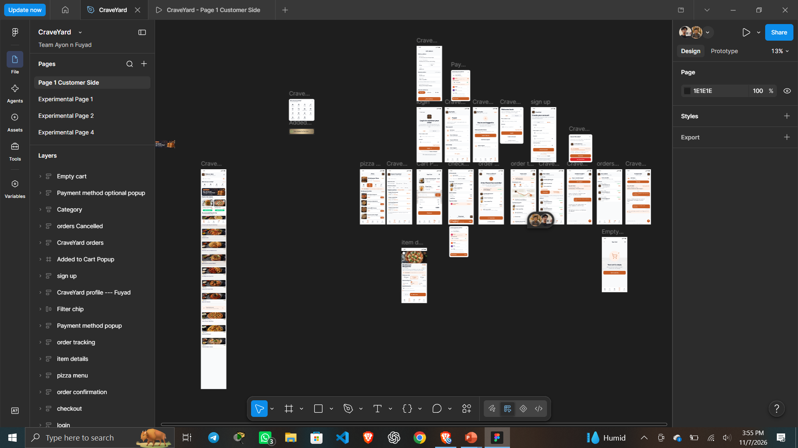
The master canvas: every screen in one place
PROJECT OVERVIEW · CraveYard
1
Page 1: Customer Side
Production page holding every mobile screen
2
Stretched Home Page
A scrollable Home Page which acts as the landing page of the app
3
24 Frames
Describing a fully working app that has currently 24 frames and more to be added later
Notes:
This is screenshot 288, our main Figma canvas on Page 1, Customer Side. The screens are laid out left to right in the order a user moves through the app, and the pop-ups and bottom sheets sit below the main flow. Having everything on one page made reviewing the whole experience easy.

Slide 4
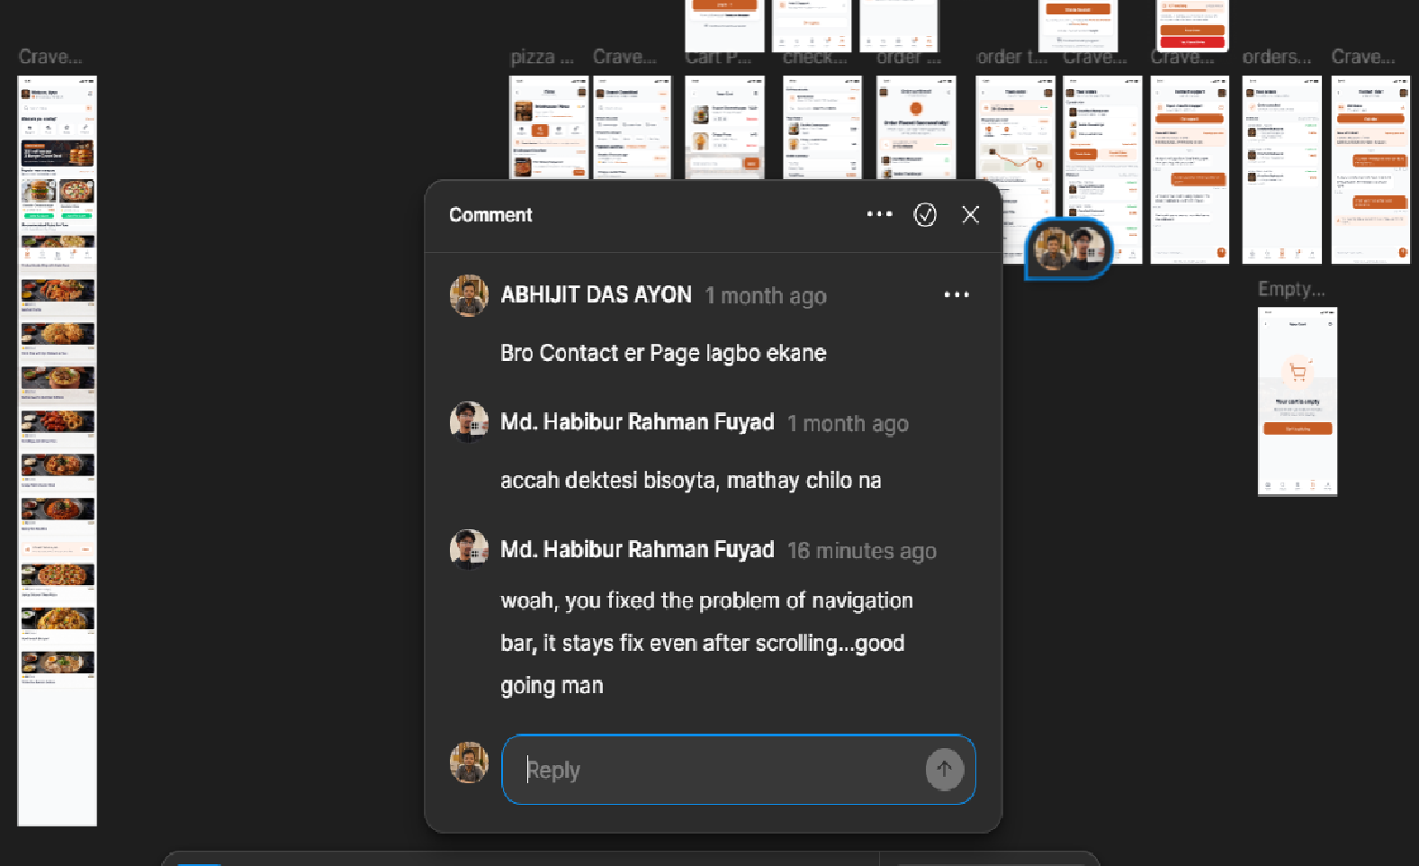
Designing together in real time
01 · COLLABORATION
1
One shared Project
No exports, no merging, always the latest version
2
Live cursors
We saw each other's edits as they happened
3
Communication
Each of us owned a set of frames and flows and communicated through comments live
Notes:
Figma is multiplayer, so we never passed files back and forth. Both of us were in the same file at once, seeing each other's cursors, splitting the screens between us and leaving comments directly on the frames. Feedback was immediate and there were no versions to merge.

Slide 5
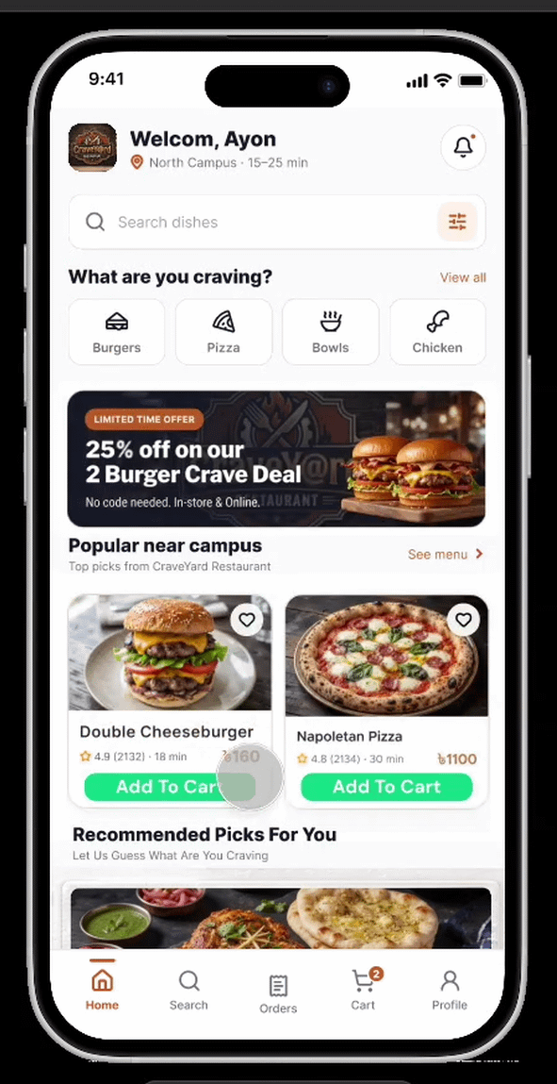
Making pages scroll like a real app
02 · SCROLLABLE PAGES
Extend the content
Stack the sections in a vertical auto layout taller than the screen
1
Pin the essentials
Fix the header and bottom tab bar so they stay in place
2
Set the scrolling
In Prototype, set Overflow scrolling to Vertical
3
Result: long pages scroll while navigation stays fixed
Notes:
Our pages are taller than the phone screen, so the content body is a vertical auto layout that extends past the frame. We pinned the top bar and the bottom tab bar using Fix position when scrolling, and set the overflow scrolling to vertical. That gives the native app feel when you preview the prototype.

Slide 6
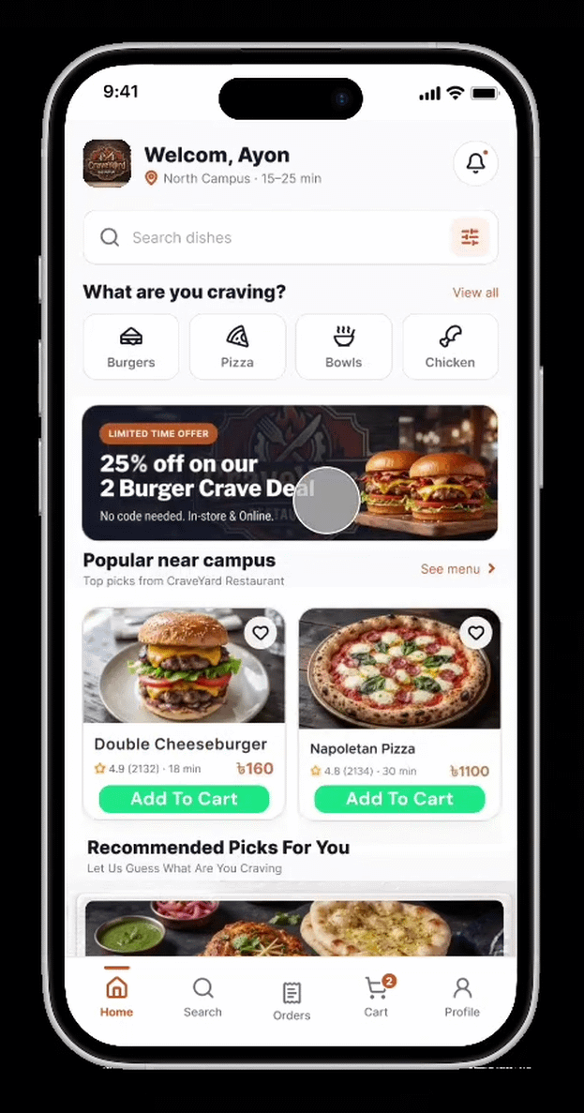
Building a swipeable carousel
03 · CAROUSELS
Build the row
Place the food cards in a horizontal auto layout with an even gap
1
Clip the frame
Keep the parent at screen width and turn on Clip content
2
Set the scrolling
In Prototype, set Overflow scrolling to Horizontal
3
Result: cards swipe sideways inside a fixed frame
Notes:
For rows like popular food and discount banners, we used a horizontal auto layout, so the cards sit evenly with a fixed gap. The parent frame is kept at screen width with Clip content on, and in the prototype we set the overflow scrolling to horizontal. The cards then swipe sideways inside the screen.

Slide 7
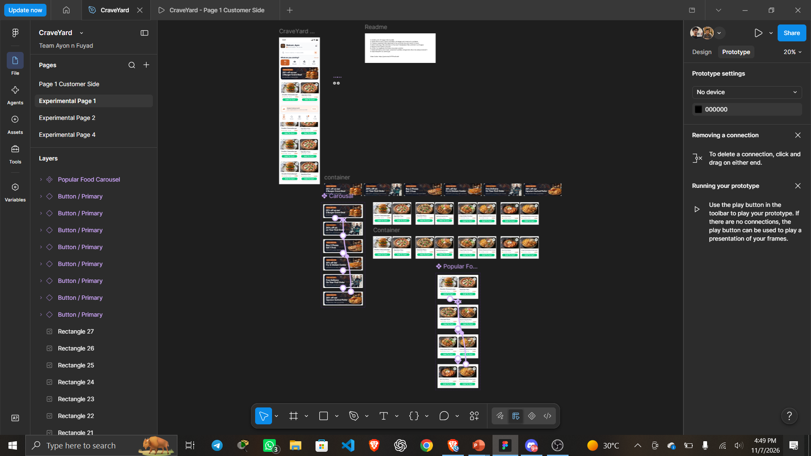
Experimenting first, then moving to production
04 · EXPERIMENTAL PAGES
1
Sandbox pages
Experimental Page 1 and 2 hold the rough ideas
2
Test in isolation
Layouts, carousels and interactions tried safely
3
Promote when ready
Only finished designs reach Page 1
Notes:
This is screenshot 289, showing the pages in our file. Besides Page 1, we kept Experimental Page 1 and 2 as sandboxes. We tried rough layouts, carousels and interactions there, and only moved a design to the main canvas once it worked. That kept the production page clean.

Slide 8
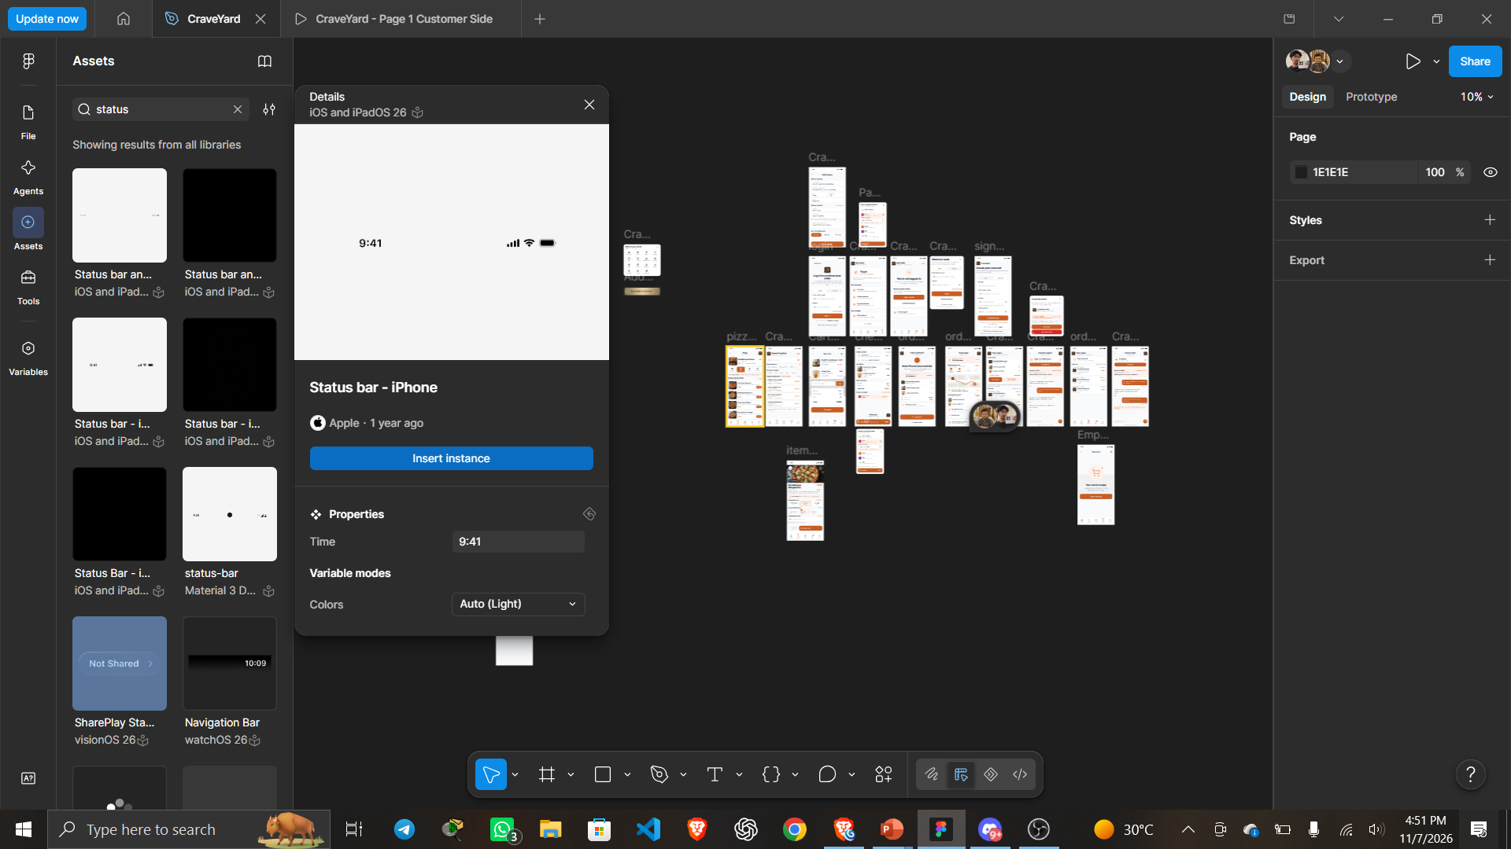
Reusing community assets to move faster
05 · COMMUNITY COMPONENTS
1
Community UI kits
iOS status bar, icons and system elements
2
Brand assets
Payment logos such as bKash, Nagad and Upay
3
Our own components
Buttons, food cards and chips reused everywhere
Notes:
Instead of redrawing everything, we used Figma Community resources for the system pieces, such as the iOS status bar, tab icons and payment logos. On top of that we built our own master components for buttons and food cards, so any change updates every screen that uses them.

Slide 9
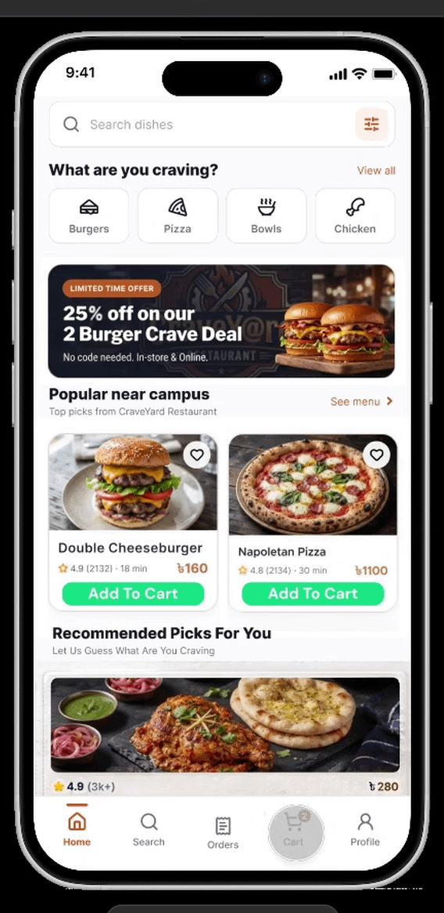
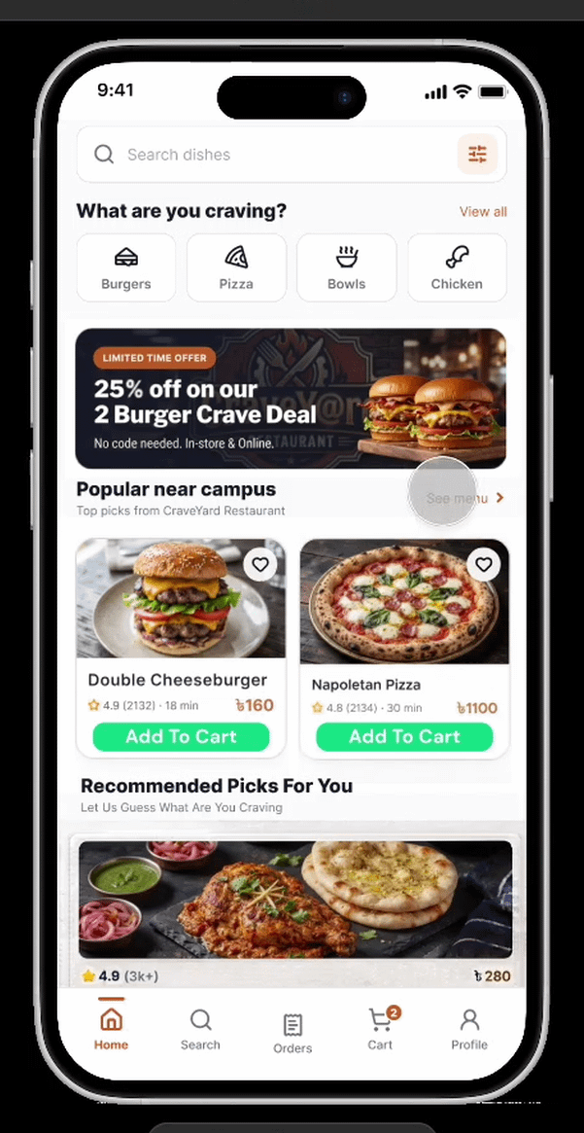

Connecting every button into a flow
06 · PROTOTYPING
1
On tap
Every card and button has a trigger
2
Open overlay
The customise sheet slides up over the menu
3
Navigate
Add to cart leads straight to the basket
Address & Payment
Order Placement
Cart
Notes:
We connected every tappable element. Tapping a dish card opens the item details as an overlay that slides up, and the add to cart button takes the user to the basket. We checked each screen so there are no dead ends and the whole journey can be tested end to end.

Slide 10
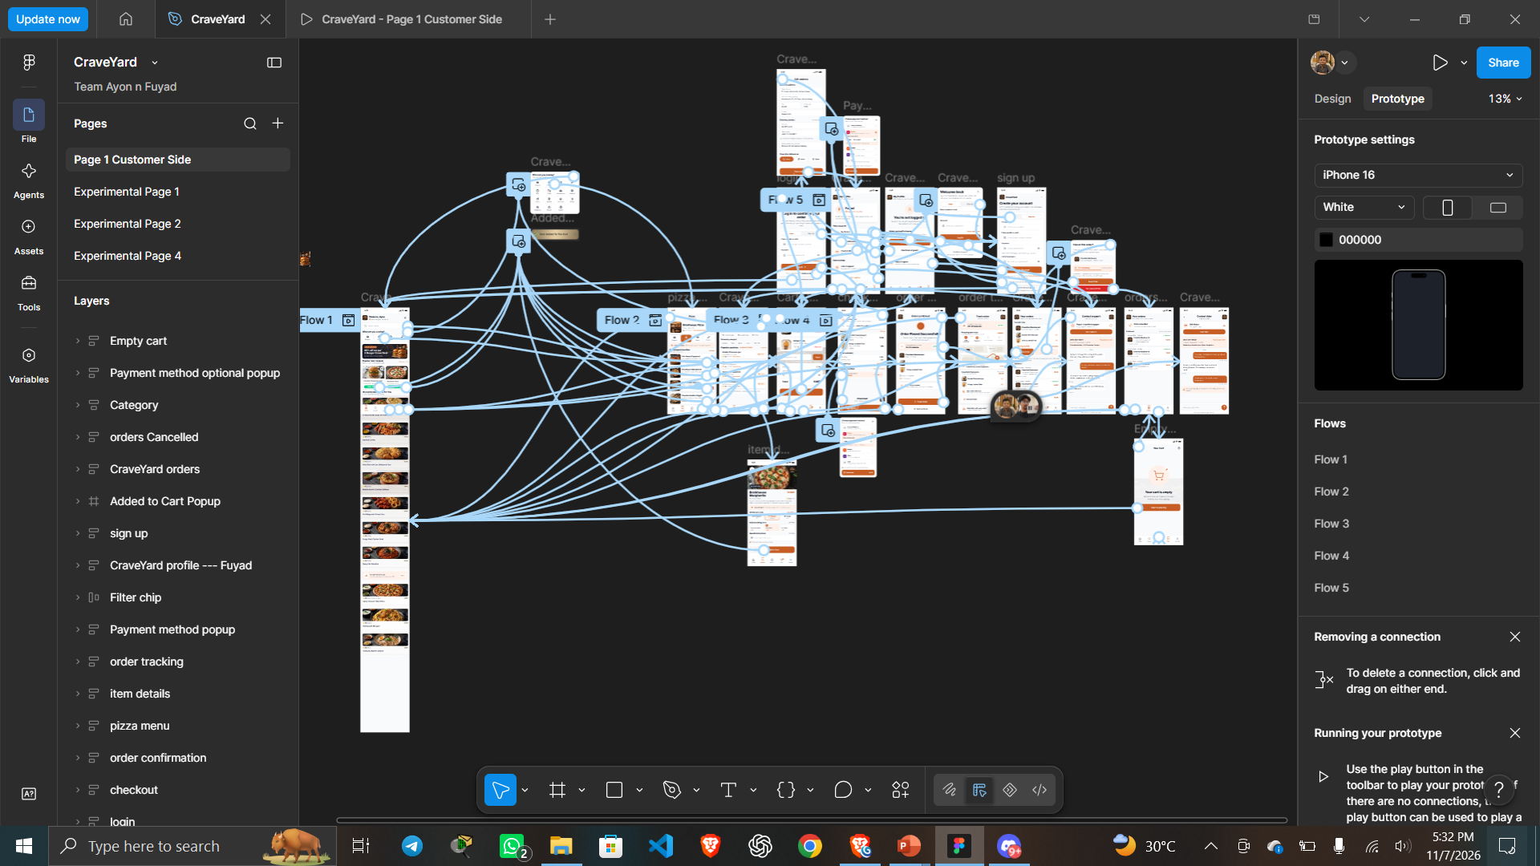
Interaction settings behind the flow
06 · PROTOTYPING
1
Trigger: On tap
Cards, buttons, tabs and back arrows
2
Action: Navigate or overlay
Screens navigate, sheets and pop-ups open as overlays
3
Animation: smooth
Slide up for sheets, smooth moves between screens
Notes:
In the Prototype tab, each connection has a trigger, an action and an animation. Most of ours are on tap. We used navigate for full screens, open overlay for sheets and pop-ups, and back for the arrows, with smooth transitions so the prototype feels like a finished app.

Slide 11
PART 2
App Functionalities
A screen-by-screen walkthrough of the CraveYard prototype
PRESENTED BY
WHAT YOU WILL SEE
Md Habibur Rahman Fuyad
Discover, order, track
ID: 0182420012101032
Home, search, menu and cart
Part 2 of the presentation
Payment, tracking and support
Notes:
Thank you, Ayon. I am Md Habibur Rahman Fuyad. I will now walk you through the actual screens of CraveYard, following a student from finding food to receiving the order.

